Slide 1
SHOPPING ANNUITY

Slide 2
WHAT IS SHOPPING ANNUITY?
WHY IS IT IMPORTANT?
THE SHOPPING ANNUITY IS A REVOLUTIONARY CONCEPT THAT HELPS SMART SHOPPERS CONVERT THEIR SPENDING INTO EARNING THROUGH SHOP•COM.

Slide 3
HOW DO I ACHIEVE MY 1500 BVs PER QUARTER PER PERSON?
HOW DO I BUILD MY OWN SHOPPING ANNUITY?
HOW DO I MAKE THE SWITCH?
STEP 1
HOME SHOPPING LIST
SHOPPING ANNUITY ASSESSMENT
Notes:
ANALYZE & EXAMINE MY OWN SPENDING HABITS, TO IDENTIFY AREAS WHERE I MAY BE MISSING OPPORTUNITIES TO TRANSFER MY PURCHASES TO SHOP•COM AND CONTRIBUTE TO YOUR SHOPPING ANNUITY.

Slide 4
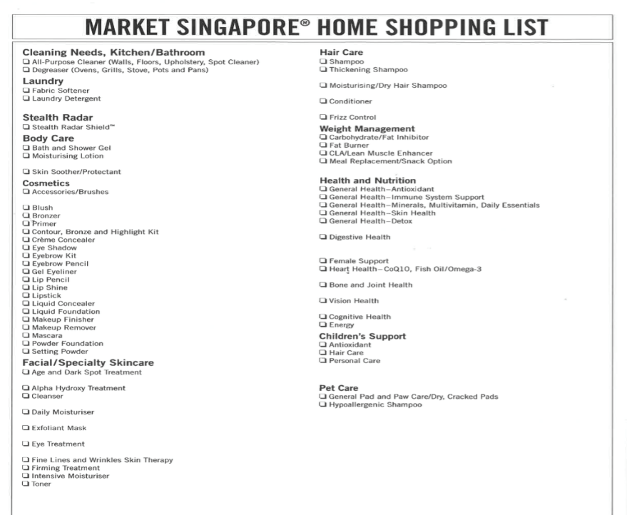

Slide 5
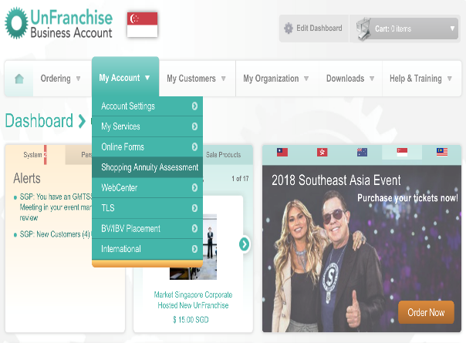
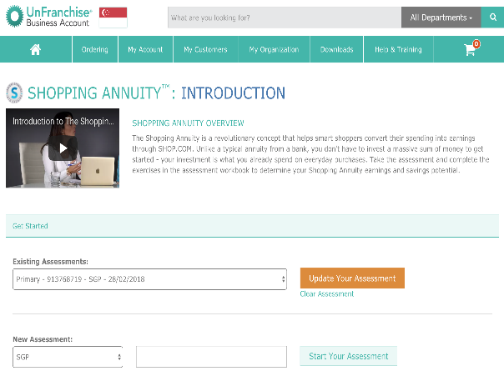
Shopping Annuity Assessment

Slide 6
STEP 2
IDENTIFY ADDITIONAL PRODUCTS AND MAKE THE SWITCH.
PARTNER STORES
ON LINE
OFF LINE

Slide 7
STEP 3
HOW DO I AUTOMATED MY EARNING?
AUTOSHIP
WEEKLY, BI-WEEKLY, MONTHLY & QUARTERLY

Slide 8
MY TESTIMONY

Slide 9
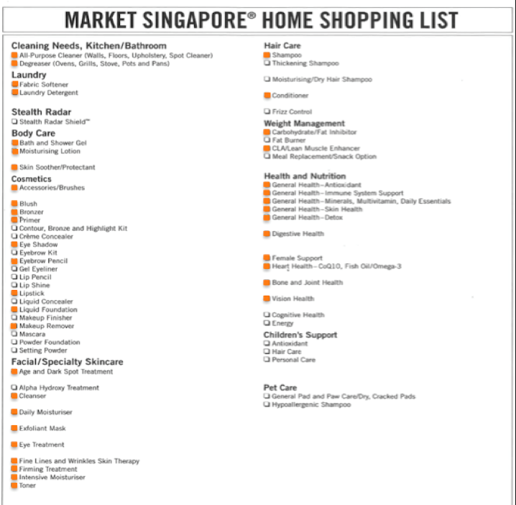

Slide 10
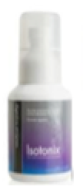
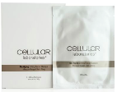
½ month
1-month
1-½ months
2-months
6-months
3-months

Slide 11
BVs calculation:
½-months → 41.50 BV x 24 = 996 BV
1-months → 326.50 BV x 12 = 3,918 BV
1-½ months → 42.00 BV x 8 = 336 BV
2-months → 456.00 BV x 6 = 2,739 BV
3-months → 115.25 BV x 4 = 461 BV
6-months → 23.50 BV x 2 = 47 BV
8,497 BV / 12 months
= 708 BV per month
2,124 BVs per quarter per person

Slide 12
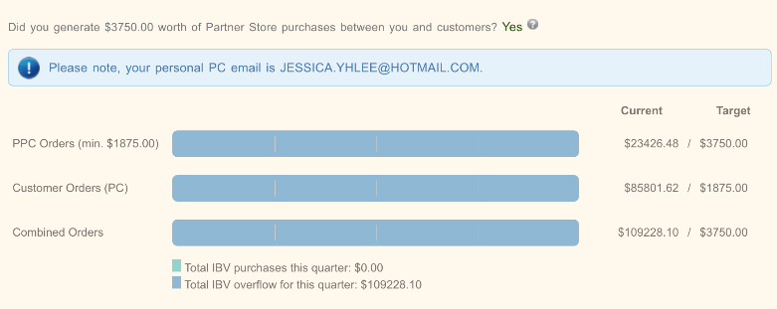

Slide 13
Let the
UnFranchise DNA
Be in YOU!
LEAD BY EXAMPLE!!

